Slide 1
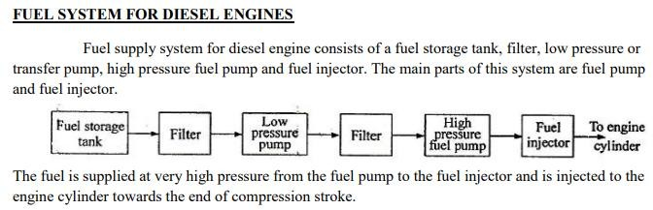

Slide 2
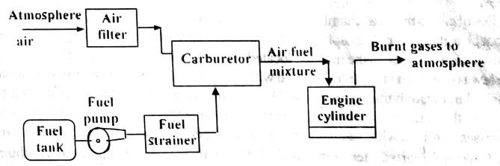
FUEL –AIR SYSTEM FOR CARBURETTED PETROL ENGINE

Slide 3
Carburetor
The carburetor is a device for atomising and vapourising the fuel and mixing it with the air in the varying proportions to suit the changing operating conditions of the engine.
The process of breaking up and mixing the fuel with the air is called carburetion

Slide 4
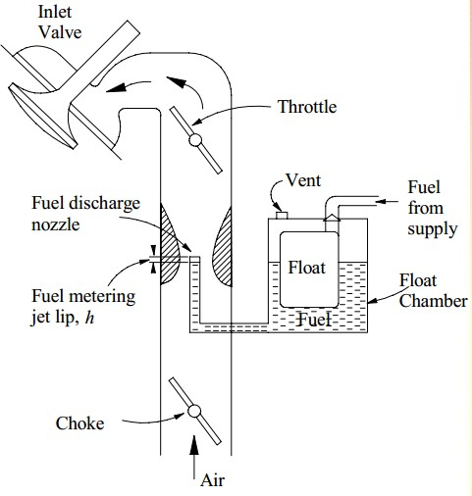
Simple Carburetor
Needle valve
Float chamber
Vent
Venturi
Nozzle
Throttle valve

Slide 5
Needle valve attached to the float lever serves to close or open the fuel inlet to the float
chamber depending upon the requirement. Thus a constant head of fuel is maintained in the
float chamber.
A small vent in the float chamber keeps the pressure inside atmospheric.
Venturi is simply a restriction in the air passage. Increase in velocity & decrease in pressure is caused at the throat of the venturi where nozzle tip is located. Due to this depression being applied at the nozzle, the fuel comes out and is vaporized by the incoming air stream.
The mixture then goes through the inlet manifold, to the engine cylinder.
The purpose of a throttle valve is to control the quantity of air fuel mixture.

Slide 6
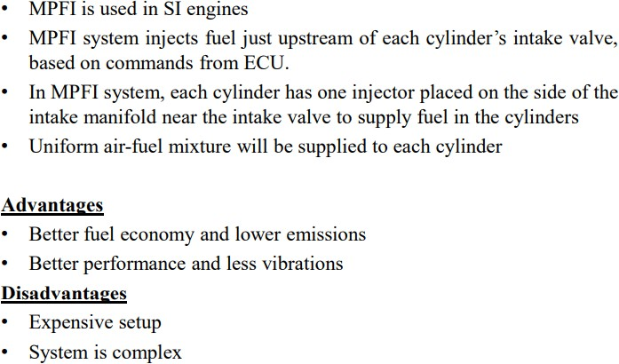
MULTI POINT FUEL INJECTION(MPFI)

Slide 7
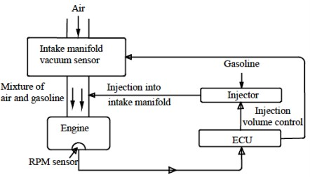
MULTI POINT FUEL INJECTION(MPFI)

Slide 8
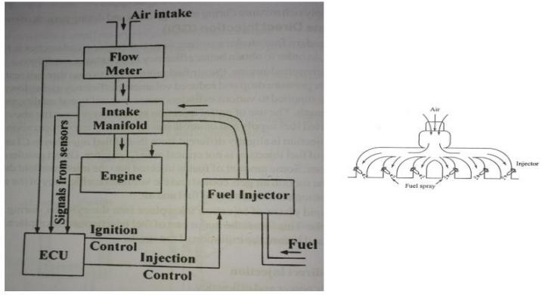
MULTI POINT FUEL INJECTION(MPFI)

Slide 9
Methods of Engine Cooling
Air cooling
Liquid cooling

Slide 10
Air cooling
In this system, the heat is dissipated directly to the atmospheric air by conduction through the cylinder walls.
In order to increase the rate of cooling, the outer surface area of the cylinder and cylinder head is increased by providing radiating fins.
In bigger units, fans are provided to circulate the air around the cylinder walls and cylinder head.

Slide 11
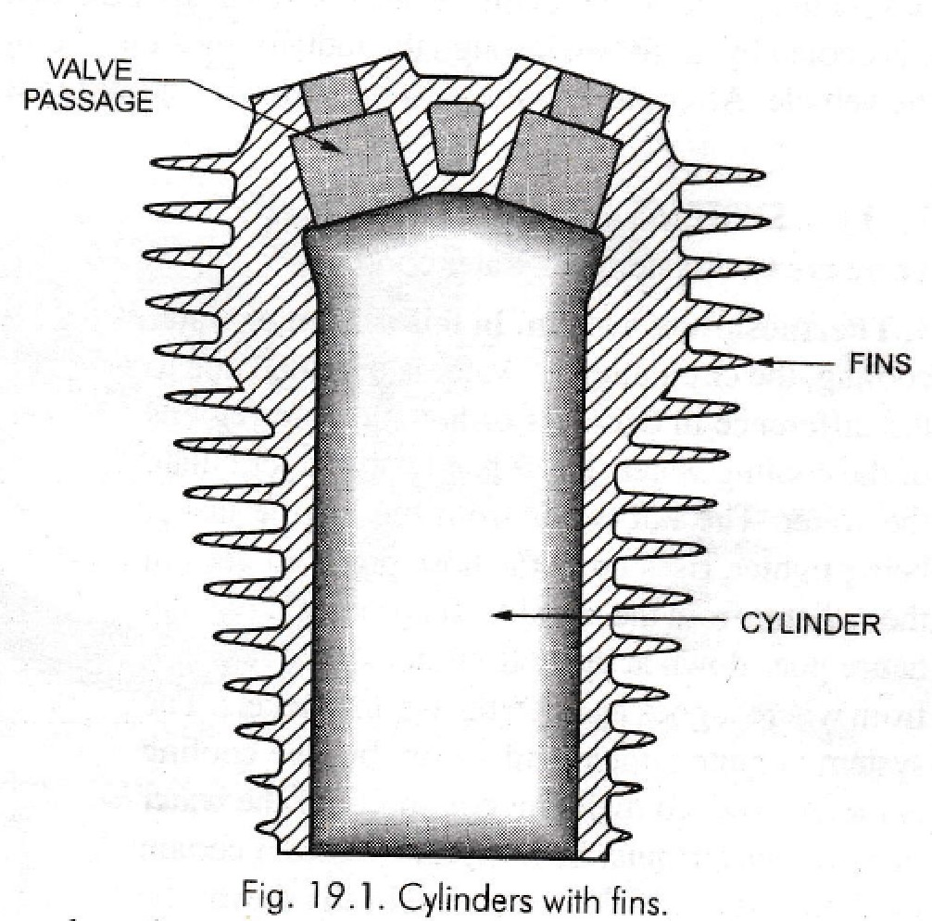
Air cooling
Cooling fins
Fan cooling
The amount of heat dissipated depends on
Surface area of metal in contact with air
Rate of air flow
Temperature difference between the heated surface and the air
Conductivity of the metal.

Slide 12
Water cooling
In this system, the water is circulated through water jackets around each of the combustion chambers, cylinders, valve seats etc.
The water is kept continuously in motion by a centrifugal water pump which is driven by a V-belt from the pulley on the engine crank shaft.
After passing through the engine jackets in the cylinder block and heads, the water is passed through the radiator. In the radiator, the water is cooled by air drawn through the radiator by a fan.
The water is again circulated through the engine jackets

Slide 13
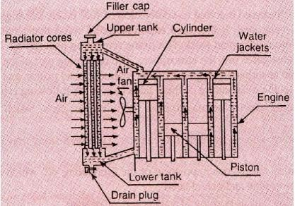
Water cooling

Slide 14
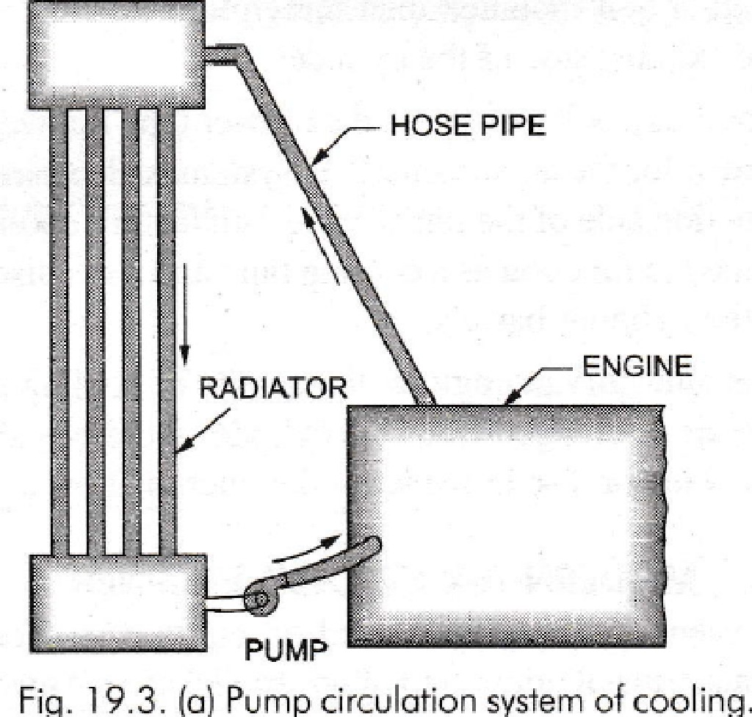
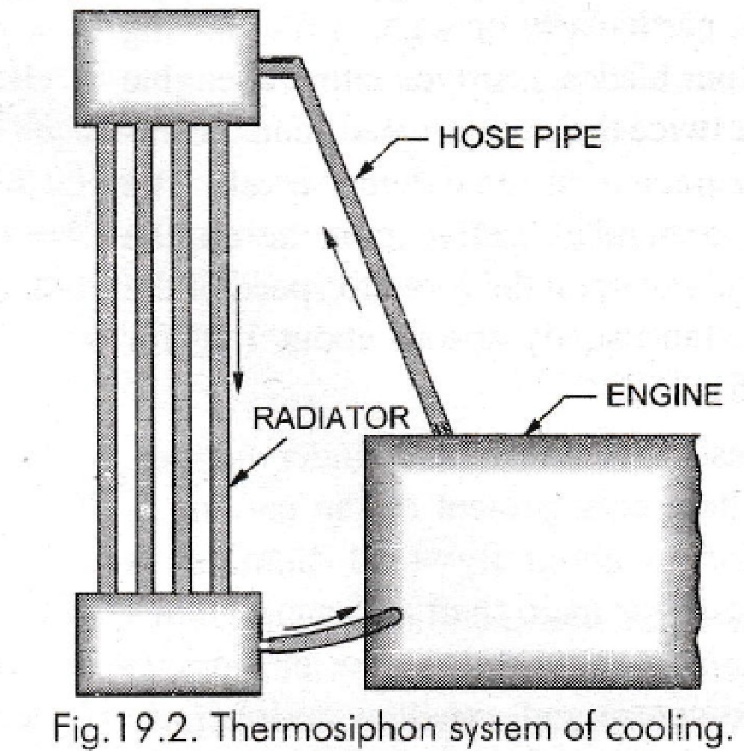
Water cooling

Slide 15
Lubrication Systems
As a matter of fact, the moving parts of an I.C. engine are likely to wear off due to continuous rubbing action of one part with another.
In order to avoid an early wearing of the engine parts, a proper lubrication arrangement is provided in I.C. engines.
Petroil system
Splash system
Pressure system

Slide 16
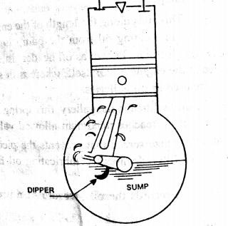
Splash system
This is one of the methods of the system.
cheapest lubrication
It consists of a scoop, which is fitted at the lower end of the connecting rod as shown in the diagram.
As when the engine runs scoop splashes, the oil from oil through by centrifugal force to all engine parts.

Slide 17
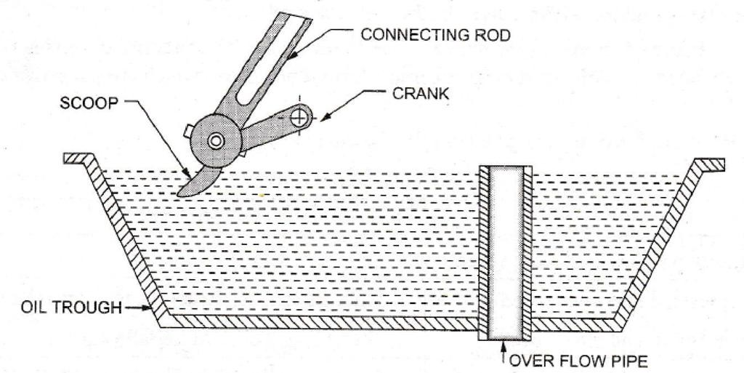
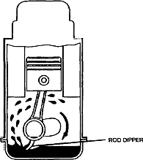
Splash system

Slide 18
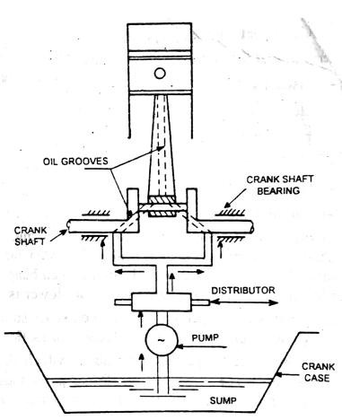
Pressure system
This method, the lubricating oil is carried in a separate tank and is pumped at a high pressure to the small gap between mating surfaces.
It supplying oil to the various parts of engine such as crank shaft bearings, camshaft , valve mechanism etc.

Slide 19
IGNITION SYSTEMS OF PETROL ENGINES
1. Coil ignition system
2. Magneto ignition system.

Slide 20
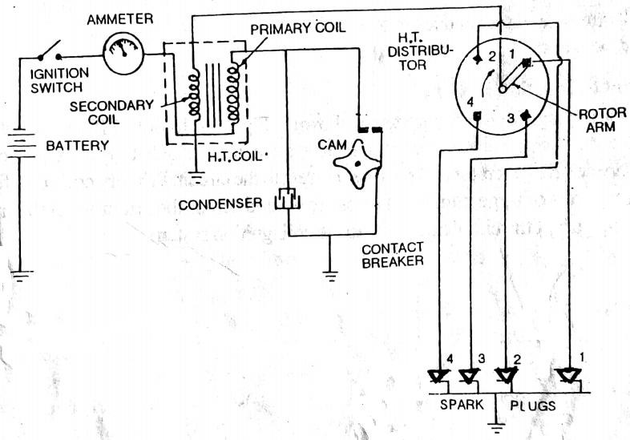
Battery Ignition System

Slide 21
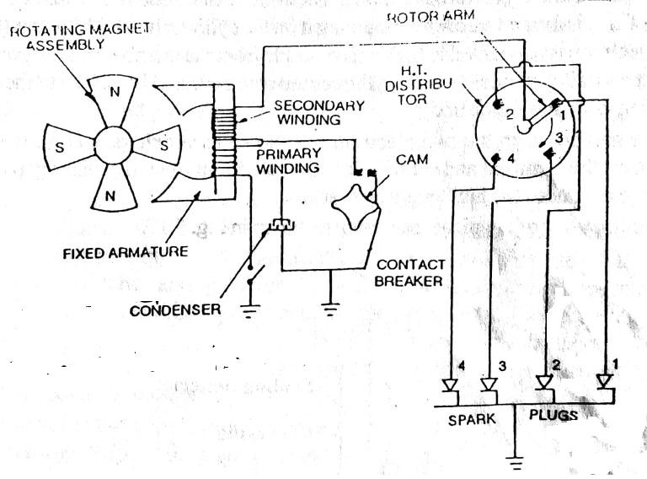
Magneto Ignition system

